Slide 1
Problem Solving with C Programming Language
Unit 2: Assignment Statements in C Programming Language

Slide 2
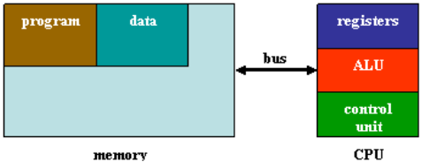
Basic Computer Operations
Most modern computers store data and programs in memory.
Computers of this model are called stored-program computers and called von Neumann architecture originally devised by John von Neumann.
The block diagram of a von Neumann architecture is composed of a memory and a central processing unit (CPU) which are connected by a bus.
Programs and data are stored in memory.
During program execution time, program instructions and data items are loaded to CPU registers and then program instructions are executed by arithmetic and logical unit (ALU) to manipulate data. After data items being processed, their results are stored back to the data area in memory.
von Neumann architecture

Slide 3
Identifiers and Variables in C
The term identifier is a synonym of name.
Programming language syntax is usually specified using a formal method called Backus-Naur Form (BNF).
An informal description of syntax rules of identifiers for C programming language is:
Syntax: a sequence of English letters (A, B,… Z, a, b, …, z), digits (0, 1, …, 9), and the underscore (_) starting with an English letter or the underscore.
BNF rules:
〈identifier〉::= 〈identifier〉〈letter〉| 〈identifier〉〈digit〉
〈identifier〉〈underscore〉|
〈letter〉| 〈underscore〉
〈letter〉::= A | B | C | … | X | Y | Z | a | b | c | … | x | y | z
〈digit〉::= 0 | 1 | 2 | 3 | 4 | 5 | 6 | 7 | 8 | 9
〈underscor〉::= _

Slide 4
Identifiers and Variables in C (cont’d)
Examples are a, id, count, PI, _this_is_an_identifier, abc123def, letters_digits_underscore, and aaa_bbb_ccc.
However, 2abcd, it's, and this-is-not-an-identifier are not identifiers.
Two remarks about identifiers of C programming language are:
Identifiers have no length limit, e.g., a_very_very_long_identifier_it_has_no_limit_on_the_length.
Identifiers are case sensitive, e.g., abc, ABC, Abc, and AbC are different identifiers.

Slide 5
Reserved Words
C programming language specifies a set of reserved words which are used for special purpose and cannot be used as an identifier. The list of reserved words is:
auto break case char const continue
default do double else enum extern
float for goto if int long
register return short signed sizeof static
struct switch typedef union unsigned void
volatile while
A reserved words cannot be used as a constant or variable identifier.

Slide 6

Variables
All program variables must be declared before they are referenced.
In the theory of programming language, a program variable is characterized with six attributes:
Name: the identifier of a variable,
Location: also known as address, the memory address of a variable,
Value: the content of a variable's memory location,
Type: the data type of a variable,
Scope: the program context that a variable is visible, and
Lifetime: the period of execution time when a variable is bound to a memory location.
Name, location, value of a program variable is depicted using the diagram on the right-hand-side.

Slide 7
Variables (cont’d)
In the previous diagram, a variable is denoted using its identifier (name), the variable location is represented as a rectangle, and the content of a variable location is indicated by an arrow pointing to a circle meaning a value.
A variable appears in the form of its name in a C program, but it may refer to a location or a value. There are rules implying reference of different variable attributes:
A variable appearing in a declaration refers to its location, e.g., int a.
A variable appearing on the left-hand-side of an assignment refers to its location, e.g., variable a in a = b + 10. This variable is called an lvalue variable.
A variable appearing in an expression on the right-hand-side of an assignment refers to its value, e.g., variable b in a = b + 10.
Note that, in the case of scanf("%d", &a), &a denotes the location of variable a.

Slide 8
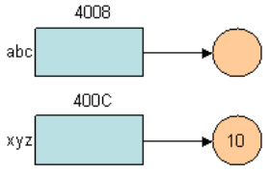
Variables (cont’d)
Let us consider the following integer declarations: int abc, xyz = 10;
If variable abc is stored at memory location 0x4008 and variable xyz is stored at memory location 0x400C, they are depicted as the following diagrams:
It shows variables named abc and xyz at memory location 0x4008 and 0x400C (we omit the hexadecimal prefix 0x) with value unknown and 10, respecitvely.

Slide 9
Variables (cont’d)
A variable in a C program declared outside all functions is called a global variable.
A variable declared in a function (subroutine) is called a local variable to that function.
A variable can be declared with the reserved word static in front of the type name.
A global variable can be referenced by all functions, i.e., its scope is all functions of the program.
A local variable is only accessible by the statements of the function declaring it, i.e., its scope is the function itself.
Global variables and static variables are bound to memory locations from the beginning the end of program execution, i.e., their lifetime is the entire program execution time.
A static variable will retain its value even when execution of its corresponding function is completed.
That is, a static variable is history-sensitive.
A non-static local variable is bound to a memory location only when the function declaring this variable is activated, i.e., the lifetime of a non-static local variable is from the time its corresponding function is called to completion time of the function.

Slide 10
Variables (cont’d)
Consider the following program.
Variable a is a global variable because it is declared outside functions foo and main.
Function foo consists of two local variables: a static variable m and a non-static variable n.
Function main consists a non-static local variable b.
int a;
void foo (void) {
static int m;
int n;
…
}
int main (void) {
int b;
…
}
The scope of global variable a is the entire program that it can be accessed by the statements of functions foo and main. However, variables m and n can only be accessed by the statements of foo and variable b is only accessible by the statements of function main.

Slide 11
history_sensitive.c
history_sensitive.exe
1
2
3
4
5
6
7
8
9
10
11
12
13
14
15
16
17
#include <stdio.h>
void foo(void) {
static int a = 0;
int b = 0;
a = a + 1;
b = b + 1;
printf("a: %d, b: %d\n", a, b);
}
int main(void) {
foo();
foo();
foo();
return 0;
}
a: 1, b: 1
a: 2, b: 1
a: 3, b: 1
Program example history_sensitive.c contains two functions foo() and main().
Two integer variables are, one static and another non-static, are declared and their values are output in function foo().
Function foo() is called in function main() three times. Static variable a is initialized to 0 only when function foo() is called at the first time and then its value is preserved. Starting from the second time when foo() is called, the value of static variable a is accumulated. In Line 9, the output value of a is 1, 2, and 3 in three calls of foo(), respectively.
Hence, it is a history-sensitive variable. However, the non-static variable b is initialized when every time foo() is called. In Line 9, the output value of b is always 1.

Slide 12
Constants
A variable can be defined as a constant, i.e., its value will stay the same during its lifetime.
A constant in C programming language is defined by the reserved word const in front of a type name as the following syntax:
Syntax: const type identifier = value
Examples of constant definition are:
const float PI = 3.14159; // a floating-point constant
const int addr = 0x4040; // a hexadecimal constant of decimal value 16448
const float a = 12.5432e3; // a floating-point constant of value 12543.200000

Slide 13
Type Definitions
C programming language allows definition of new types in a program. A type definition starts with the reserved word typedef and followed by a type and an identifier as the following syntax:
Syntax: typedef type identifier
Type definition in C is for the purpose of convenience that it does not enforce type checking of user defined types.
That is, variables of different user defined type may be assigned to each other.
However, some programming languages such as Java's classes are not type compatible.
Consider the following C program temperature_c2f.c:

Slide 14
temperature_c2f.c
1
2
3
4
5
6
7
8
9
10
11
12
13
14
15
16
17
#include <stdio.h>
typedef float centigrade;
typedef float fahrenheit;
int main(void) {
centigrade cDeg;
fahrenheit fDeg;
printf("Please enter a temperature degree in Centigrade: ");
scanf("%f", &cDeg);
fDeg = cDeg * 9.0 / 5.0 + 32.0;
printf("The temperature is %4.2f degrees Fahrenheit.\n", fDeg);
return 0;
}
The program defines two new data types centigrade and fahrenheit with the base type float in Lines 3 and 4.
In Lines 8 and 9, variables cDeg and fDeg are declared as centigrade and fahrenheit type, respectively.
In C programming language, variables of different user defined types can be accessed in a statement without explicit type conversion if they are defined with the same base types.
Hence, Line 13 contains variables of both centigrade and fahrenheit types.
temperature_c2f.exe
Please enter a temperature degree in Centigrade: 37.5
The temperature is 99.50 degrees Fahrenheit.

Slide 15
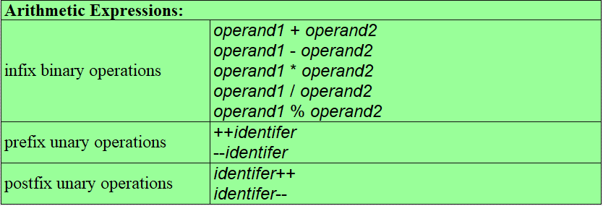
Arithmetic Expressions
An expression is a constant, a variable, an arithmetic expression, or a logical expression.
Most high-level programming languages support arithmetic operations and logical operations.
Arithmetic operations and logical operations can be written as expressions.
In C programming language, the syntax of arithmetic expressions can be specified as the following BNF rules:

Slide 16
Arithmetic Expressions (cont’d)
For infix binary operations, symbols +, -, *, and / are the addition, subtraction, multiplication, and division operators. They can be applied to operands of any primitive data type.
Symbol % is the remainder operator which is applied to integer operands only.
Note that char, int, short, long, and their unsigned data types are treated as integers when they are applied to arithmetic operations.
The spaces before and after the operators are not required that no spacing or more than one spaces is also allowed.
The operands themselves can be other arithmetic expressions. For example, expression a*b+c*d has a*b and c*d as the operands of addition +.

Slide 17
Arithmetic Expressions (cont’d)
The prefix and postfix unary operations are applied to a variable of primitive data types only.
In fact, these prefix and postfix unary operations are assignment statements, not as simple as expressions.
Both expressions ++a and a++ are equivalent to assignment a=a+1 and expressions --a and a-- are equivalent to assignment a=a-1.
That is, Lines 1 to 3 have the same computational effect and Lines 4 to 6 have the same computational effects.
1
2
3
4
5
6
a = a + 1;
++a;
a++;
a = a - 1;
--a;
a--;

Slide 18
Arithmetic Expressions (cont’d)
When an unary operation appears as an operand in an arithmetic expression, the prefix and postfix operations may cause different side effect.
If a prefix operation is an operand of another operation, the increment/decrement operation is performed before the value of the variable is loaded.
If a postfix operation is an operand of another operation, the value of the variable is loaded before the increment/decrement operation is performed.
Program prefix_postfix.c.
Both ++a and b++ will set the values of variable a and b to 11.
However, c is 16 which is the sum of the new value, 11, of variable a and 5; d is 15 which is the sum of the original value, 10, of variable b and 5.

Slide 19
prefix_postfix.c
1
2
3
4
5
6
7
8
9
10
11
12
13
14
#include <stdio.h>
int main(void) {
int a = 10;
int b = 10;
int c, d;
c = ++a + 5;
d = b++ + 5;
printf("a: %d, b: %d\n", a, b);
printf("c: %d, d: %d\n", c, d);
return 0;
}
prefix_postfix.exe
a: 11, b: 11
c: 16, d: 15
The prefix and postfix operations in C programming language are only abbreviation of assignment statements with special semantics. Whenever you have a doubt of their computational effect, it is a good idea not to use prefix and postfix operations in your program. They can be written as a sequence of assignment statements.
The statement of Line 8 can be rewritten as:
a = a + 1;
c = a + 5;
The statement of Line 9 can be rewritten as:
d = b + 5;
b = b + 1;

Slide 20
Arithmetic Expressions (cont’d)
In a programming language, arithmetic operations must be evaluated in a given order to ensure correct computational results.
Conventionally, multiplications and divisions are evaluated before addition and subtraction if a sub-expression is not enclosed by parentheses.
That is, multiplications are evaluated first before additions in expression a+b*c and a*b+c.
Parentheses are required, e.g., (a+b)*c and a*(b+c), to force additions being evaluated before multiplications.
Associativity is an issue when a program contains expression such as a-b-c and a/b/c, a%b%c.
Left to right associativity will result in (a-b)-c, (a/b)/c, and (a%b)%c.
Right to left associativity will result in a-(b-c), a/(b/c), and a%(b%c).
They will give different computational results.

Slide 21
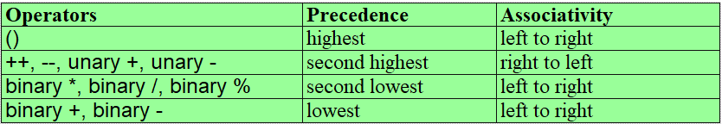
Arithmetic Expressions (cont’d)
In C programming language, precedence rules and associativity rules of arithmetic operations are specified as below:
However, for an expression, such as operand1+operand2, evaluation order of the two operands are not specified in C programming language.

Slide 22
evaluation_order.c
1
2
3
4
5
6
7
8
9
10
11
12
#include <stdio.h>
int main(void) {
int a = 2;
int b = 3;
int c;
c = (++a) + a * b;
printf("a: %d, b: %d, c: %d\n", a, b, c);
return 0;
}
evaluation_order.exe
a: 3, b: 3, c: 12
if the values of variables a and b are 2 and 3 originally,
(++a)+a*b has result 12, if the evaluation is from left to right, and
it has result 9, if the evaluation is from right to left.

Slide 23
Assignments
Assignment is the basic statement construct of C programming language.
Syntax: variable = expression;
The equal sign = in an assignment statement is not an equivalence relation.
Its semantics is assigning the result of evaluating expression on the right-hand-side and to the content of location referenced by variable on the left-hand-side of the equal sign.
The variable on the left-hand-side of the equal sign of an assignment denotes a memory location and is called an lvalue variable.
Examples of assignments are:
a = a * a - b / (c + d * e); // Assignment of an arithmetic expression.
avg = total / count; // To compute an average.
number = pow(2, m) + pow(3, n); // assign 2^{m}+3^{n} to variable number, where pow() is // a function of C library math.h.

Slide 24

Assignments (cont’d)
According to the precedence and associativity rules, operations are evaluated in a certain order (including loading of operand values and execution of operators).
For example, the numbers below the operators and operands indicate the order of evaluation:

Slide 25
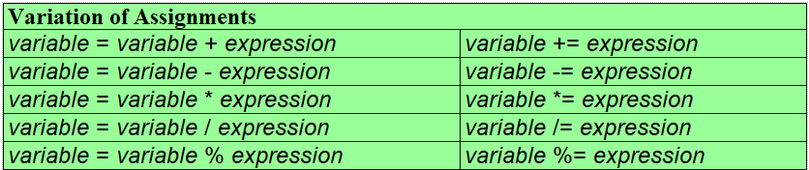
Assignments (cont’d)
C programming language also allows variation of assignment, if the left-hand-side variable is the first operand of an operator.
The assignments on the first column is equivalent to the corresponding on on the second column.
Note that, however, a*=b+c*d is not equivalent to a=a*b+c*d.
Parentheses are required to force the expression on the right-hand-side as the second operand of multiplication operator, i.e., it is equivalent to a=a*(b+c*d).

Slide 26
Assignments (cont’d)
For a strongly typed programming language, the left-hand-side variable and all variables in the right-hand-side must be type compatible, or, have the same type.
However, C programming language allows they may be declared as different types and employs an implicit type conversion rule:
When evaluating the right-hand-side expression that an operator has two operands of two different types, a "narrower" operand is converted to a "wider" operand.
The evaluation result of the right-hand-side expression is converted to the type of the left-hand-side variable.
Program type_conversion.c shows implicit type conversion of a C program.

Slide 27
type_conversion.c
1
2
3
4
5
6
7
8
9
10
11
12
13
#include <stdio.h>
int main(void) {
int a = 10, b;
float e = 10.50, f = 30.80, g, h;
b = f / a;
g = e - b;
h = e - f / a;
printf("b=%d, g=%4.2f, h=%4.2f\n", b, g, h);
return 0;
}
type_conversion.exe
b=3, g=7.50, h=7.42
In Line 7, variable f is of type float and a is of int. Hence, expression f/a will convert a to float type and performs a floating-point division to obtain quotient 3.08 and then the result is converted to an integer because b is of type int of value 3.
In Line 8, a floating-point subtraction is evaluated to yield the result 7.50. However, in Line 9, all operations are floating-point operations that the result is 7.42.
It is important to understand how data types are converted when an expression is evaluated.
If it is desirable to convert the result of f/a in Line 9 to integer type, explicit casting can be used for this purpose. That is, change Line 9 to h=e-(int)f/a.

Slide 28
Assignments (cont’d)
In C programming language, a expression is allowed to consist of assignment.
Program assignment_as_expression.c.
assignment_as_expression.c
assignment_as_expression.exe
1
2
3
4
5
6
7
8
9
10
11
#include <stdio.h>
int main(void) {
int a = 2, b = 3, c = 5;
int ans;
ans = (a = a * b) + (b = a + c);
printf("a=%d, b=%d, c=%d, ans=%d\n", a, b, c, ans);
return 0;
}
a=6, b=11, c=5, ans= ?
This contains an assignment (Line 7) whose two operands on the right-hand-side are both assignments with side-effect.
Since the evaluation order of the addition operator is from left to right, variable a in a=a*b is the original value of a and variable a in b=a+c is the new value of a after execution of a=a*b.

Slide 29
Assignments (cont’d)
It is easy to cause errors in Line 7 of this program because of uncertainty of evaluation order and complicated effect. It would be a good practice for a program not to write programmers with side effect. One solution is to rewrite the assignment of Line 7, “ans = (a = a * b) + (b = a + c);”, to the following sequence of statements:
a = a * b; b = a + c; ans = a + b;

Slide 30
Assignments (cont’d)
Finally, we show a program using constant, arithmetic operations, and assignments.
Program circle_circumference_area.c reads a radius of a circle, then, computes and outputs the circumference and area of the circle. In Line 6, constant PI is defined as the ratio of the circumference to the diameter of a circle.

Slide 31
circle_circumference_area.c
1
2
3
4
5
6
7
8
9
10
11
12
13
14
15
16
#include <stdio.h>
int main(void) {
float radius, circumference, area;
const float PI = 3.14159;
printf("Enter the radius: ");
scanf("%f", &radius);
circumference = 2 * PI * radius;
area = PI * radius * radius;
printf("Radius:\t\t%10.4f\t%10.4E\n", radius, radius);
printf("Circumference:\t%10.4f\t%10.4E\n", circumference, circumference);
printf("Area:\t\t%10.4f\t%10.4E\n", area, area);
return 0;
}
circle_circumference_area.exe
Enter the radius: 10
Radius: 10.0000 1.0000E+001
Circumference: 62.8318 6.2832E+001
Area: 314.1590 3.1416E+002

